Slide 1

Chapter 10
第10章 其他公钥密码体制
Other Public-Key Cryptosystems
Notes:
This chapter begins with a description of one of the earliest and simplest PKCS: Diffie-
Hellman key exchange. The chapter then looks at another important scheme, the
Elgamal PKCS. Next, we look at the increasingly important PKCS known as elliptic
curve cryptography. Finally, the use of public-key algorithms for pseudorandom number
generation is examined.

Slide 2
Diffie-Hellman Key Exchange
First published public-key algorithm
A number of commercial products employ this key exchange technique
Purpose is to enable two users to securely exchange a key that can then be used for subsequent symmetric encryption of messages
The algorithm itself is limited to the exchange of secret values
Its effectiveness depends on the difficulty of computing discrete logarithms
Notes:
The first published public-key algorithm appeared in the seminal paper by Diffie
and Hellman that defined public-key cryptography [DIFF76b] and is generally
referred to as Diffie-Hellman key exchange. A number of commercial products
employ this key exchange technique.
The purpose of the algorithm is to enable two users to securely exchange a
key that can then be used for subsequent symmetric encryption of messages. The
algorithm itself is limited to the exchange of secret values.
The Diffie-Hellman algorithm depends for its effectiveness on the difficulty of
computing discrete logarithms. Briefly, we can define the discrete logarithm in the
following way. Recall from Chapter 8 that a primitive root of a prime number p is
one whose powers modulo p generate all the integers from 1 to p - 1. That is, if a
is a primitive root of the prime number p , then the numbers
a mod p , a² mod p , . . . , a^{p-1} mod p
are distinct and consist of the integers from 1 through p - 1 in some permutation.
For any integer b and a primitive root a of prime number p , we can find a
unique exponent i such that
b = a^{i} (mod p ) where 0 ≤ i ≤ (p - 1)
The exponent i is referred to as the discrete logarithm of b for the base a , mod p .
We express this value as dlog_{a,p} (b ). See Chapter 8 for an extended discussion of
discrete logarithms.

Slide 3
Diffie-Hellman密钥交换
离散对数问题
y＝g^{x} mod p，其中g是生成元
求x的困难性
目前没有有效的方法
实际使用时常用Z_{p}*和ECC上的点加法群

Slide 4
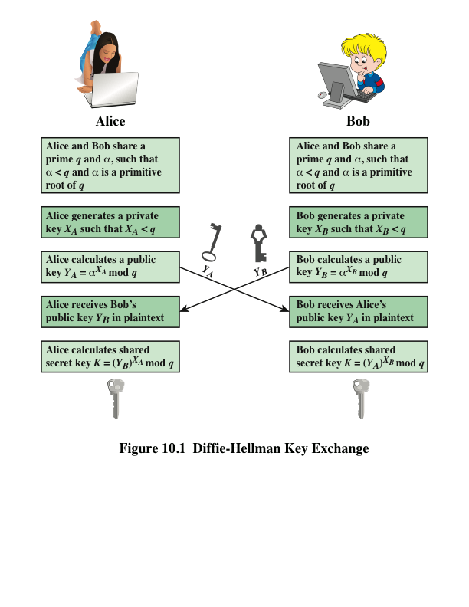
Notes:
Figure 10.1 summarizes the Diffie-Hellman key exchange algorithm. For this
scheme, there are two publicly known numbers: a prime number q and an integer a
that is a primitive root of q .

Slide 5
Diffie-Hellman密钥交换协议
DH76，Diffie-Hellman
步骤
选取大素数q和它的一个生成元g，这些参数公开
A选择随机数X_{a}，B选择随机数X_{b}
A计算Y_{a}＝g^X_{a} mod q，B计算Y_{b}＝g^X_{b} mod q
交换Y_{a}，Y_{b}
A计算K＝Y_{b}^X_{a} mod q，B计算K'＝Y_{a}^X_{b} mod q
事实上，K＝K'

Slide 6
证明、分析和例子
证明K＝K’
K＝Y_{b}^X_{a} mod q K’＝Y_{a}^X_{b} mod q
＝(g^X_{b})^X_{a} mod q ＝(g^X_{a})^X_{b} mod q
＝ g^(X_{b}X_{a}) mod q ＝g^(X_{a}X_{b}) mod q

Slide 7
证明、分析和例子
举例 q＝97，g＝5
A选Xa＝36，B选Xb＝58，则
Ya＝5^36％97＝50，Yb＝5^58％97＝44
交换50，44
A算K＝44^36％97＝75，B算K’＝50^58％97＝75
分析（别人怎么计算K?）
别人看到了Ya和Yb，但需要计算Xa或Xb，即要算离散对数
Ya＝g^Xa mod q，或Yb＝g^Xb mod q

Slide 8
Key Exchange Protocols
Users could create random private/public Diffie-Hellman keys each time they communicate
Users could create a known private/public Diffie-Hellman key and publish in a directory, then consulted and used to securely communicate with them
Vulnerable to Man-in-the-Middle-Attack
Authentication of the keys is needed
Notes:
Now consider a simple protocol that makes use of the Diffie-Hellman calculation. Suppose that user A wishes to set up a connection with user B and use a secret key to encrypt messages on that connection. User A can generate a one-time private key X_{A}, calculate Y_{A}, and send that to user B. User B responds by generating a private value X_{B}, calculating Y_{B}, and sending Y_{B} to user A. Both users can now calculate the key. The necessary public values q and a would need to be known ahead of time. Alternatively, user A could pick values for q and a and include those in the first message.

Slide 9
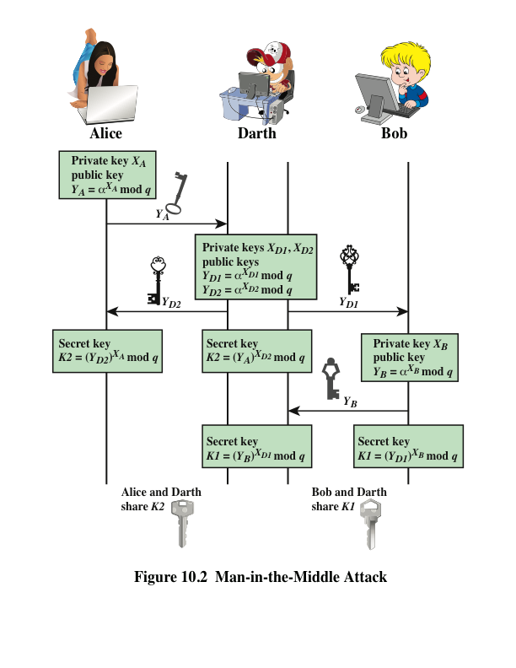
Notes:
The protocol depicted in Figure 10.1 is insecure against a man-in-the-middle attack.
Suppose Alice and Bob wish to exchange keys, and Darth is the adversary. The
attack proceeds as follows (Figure 10.2).
Darth prepares for the attack by generating two random private keys X_{D1} and X_{D2} and then computing the corresponding public keys Y_{D1} and Y_{D2}
Alice transmits Y_{A} to Bob.
Darth intercepts Y_{A} and transmits Y_{D1} to Bob. Darth also calculates K2 = (Y_{A} )^ X_{D2} mod q
Bob receives Y_{D1} and calculates K1=(Y_{D1} )^ X_{B} mod q
Bob transmits Y_{B} to Alice.
Darth intercepts Y_{B} and transmits Y_{D2} to Alice. Darth calculates K1=(Y_{B} )^ X_{D1} mod q
Alice receives Y_{D2} and calculates K2=(Y_{D2} )^ X_{A} mod q .
At this point, Bob and Alice think that they share a secret key, but instead Bob and Darth share secret key K1 and Alice and Darth share secret key K2. All future communication between Bob and Alice is compromised in the following way:
Alice sends an encrypted message M: E(K2, M).
Darth intercepts the encrypted message and decrypts it, to recover M.
Darth sends Bob E(K1, M) or E(K1, M'), where M' is any message. In the first case, Darth simply wants to eavesdrop on the communication without altering it. In the second case, Darth wants to modify the message going to Bob.
The key exchange protocol is vulnerable to such an attack because it does not authenticate the participants. This vulnerability can be overcome with the use of digital signatures and public- key certificates.

Slide 10
中间人攻击
交换Y的过程中，Y有可能被替换假冒，而且不能发现
形式上，可以理解为一个中间人在跟双方同时通信，当然通信内容在中间人那里是可见的
* 一个现实的例子就是：可以同时开两盘QQx棋，一个后手，一个先手，…

Slide 11
Man-in-the-middle
A E B
Xa Xb’ Xa’ Xb
Ya Yb’ Ya’ Yb
K=Yb’^Xa K’=Y’a^Xb

Slide 12
相关结论
maurer94towards
Towards the Equivalence of Breaking the Diffie-Hellman Protocol and Computing Discrete Logarithms
http://citeseer.nj.nec.com/maurer94towards.html
结论
破译D-H密钥协商协议等价于计算离散对数
RSA算法的安全性是否等价于大数的因子分解？

Slide 13
ElGamal Cryptography
Announced in 1984 by T. Elgamal
Public-key scheme based on discrete logarithms closely related to the Diffie-Hellman technique
Used in the digital signature standard (DSS) and the S/MIME e-mail standard
Global elements are a prime number q and a which is a primitive root of q
Security is based on the difficulty of computing discrete logarithms
Notes:
In 1984, T. Elgamal announced a public-key scheme based on discrete logarithms, closely related to the Diffie-Hellman technique [ELGA84, ELGA85]. The ElGamal cryptosystem is used in some form in a number of standards including the digital signature standard (DSS) and the S/MIME email standard.
As with Diffie-Hellman, the global elements of ElGamal are a prime number q and a, which is a primitive root of q. User A generates a private/public key pair as shown. The security of ElGamal is based on the difficulty of computing discrete logarithms, to recover either x given y, or k given K .
The security of Elgamal is based on the difficulty of computing discrete
logarithms.

Slide 14
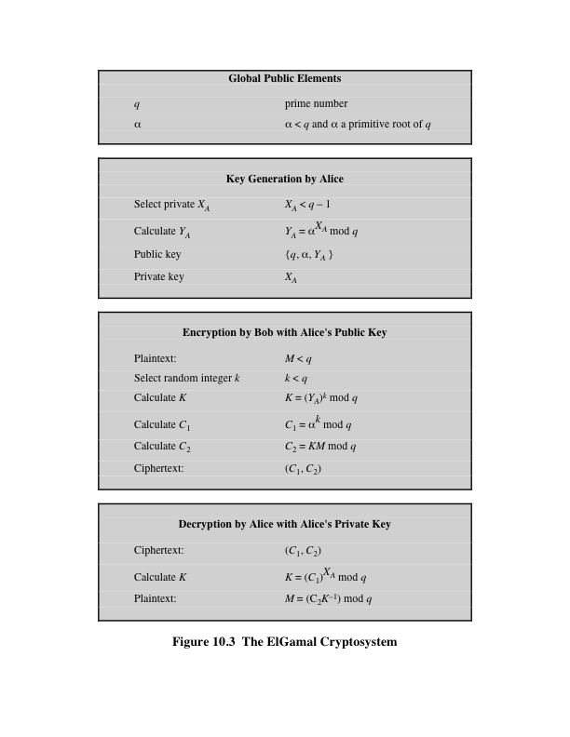
Notes:
Figure 10.3 summarizes the ElGamal Cryptosystem. It corresponds to Figure 9.1a.

Slide 15
10.2 ElGamal密码体制
准备
素数p，Z_{p}*中本原元g，公开参数
私钥a，公钥b=gª mod p
加密
对明文1<=m<=p-1，选随机数k
密文(c1, c2)
c1=g^{k} mod p, c2=mb^{k} mod p
解密
m＝c2 (c1ª)⁻¹＝mb^{k} ((g^{k})ª)⁻¹
＝m(gª)^{k} (g^{-ka})
＝m mod p
Notes:
关键是b^k＝(g^k)^a，而m被b^k掩盖，要去掉b^k得用到a； （其实也可以使用xor）

Slide 16
ElGamal etc
基于离散对数难题
缺点
需要随机数
密文长度加倍
ElGamal可以迁移到ECDLP上
ElGamal签名和DSS

Slide 17
Elliptic Curve Arithmetic
Most of the products and standards that use public-key cryptography for encryption and digital signatures use RSA
The key length for secure RSA use has increased over recent years and this has put a heavier processing load on applications using RSA
Elliptic curve cryptography (ECC) is showing up in standardization efforts including the IEEE P1363 Standard for Public-Key Cryptography
Principal attraction of ECC is that it appears to offer equal security for a far smaller key size
Confidence level in ECC is not yet as high as that in RSA
Notes:
Most of the products and standards that use public-key cryptography for encryption
and digital signatures use RSA. As we have seen, the key length for secure RSA
use has increased over recent years, and this has put a heavier processing load on
applications using RSA. This burden has ramifications, especially for electronic commerce
sites that conduct large numbers of secure transactions. A competing system
challenges RSA: elliptic curve cryptography (ECC). ECC is showing up in standardization
efforts, including the IEEE P1363 Standard for Public-Key Cryptography.
The principal attraction of ECC, compared to RSA, is that it appears to offer
equal security for a far smaller key size, thereby reducing processing overhead. On
the other hand, although the theory of ECC has been around for some time, it is
only recently that products have begun to appear and that there has been sustained
cryptanalytic interest in probing for weaknesses. Accordingly, the confidence level
in ECC is not yet as high as that in RSA.
ECC is fundamentally more difficult to explain than either RSA or Diffie-
Hellman, and a full mathematical description is beyond the scope of this book.
This section and the next give some background on elliptic curves and ECC. We
begin with a brief review of the concept of abelian group. Next, we examine the
concept of elliptic curves defined over the real numbers. This is followed by a look
at elliptic curves defined over finite fields. Finally, we are able to examine elliptic
curve ciphers.

Slide 18
Abelian Group
A set of elements with a binary operation, denoted by •, that associates to each ordered pair (a, b) of elements in G an element (a • b) in G, such that the following axioms are obeyed:
(A1) Closure: If a and b belong to G, then a • b is also in G
(A2) Associative: a • (b • c) = (a • b) • c for all a, b, c in G
(A3) Identity element: There is an element e in G such that a • e = e • a = a for all a in G
(A4) Inverse element: For each a in G there is an element a′ in G such that a • a′ = a′ • a = e
(A5) Commutative: a • b = b • a for all a, b in G
Notes:
Recall from Chapter 4 that an abelian group G , sometimes denoted by {G , . }, is
a set of elements with a binary operation, denoted by . , that associates to each
ordered pair (a , b ) of elements in G an element (a . b ) in G , such that the following
axioms are obeyed:
(A1) Closure: If a and b belong to G , then a . b is also in G .
(A2) Associative: a . (b . c ) = (a . b ) . c for all a , b , c in G .
(A3) Identity element: There is an element e in G such that a . e = e . a = a
for all a in G .
(A4) Inverse element: For each a in G there is an element a′ in G such that
a . a′ = a′ . a = e.
(A5) Commutative: a . b = b . a for all a , b in G .

Slide 19
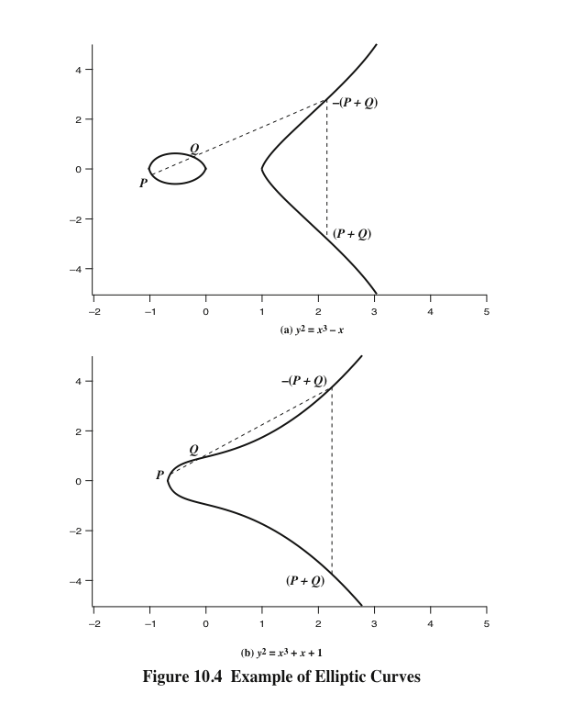
Notes:
Elliptic curves are not ellipses. They are so named because they are described by
cubic equations, similar to those used for calculating the circumference of an ellipse.
In general, cubic equations for elliptic curves take the following form, known as a
Weierstrass equation:
y² + axy + by = x³ + cx² + dx + e
where a , b , c , d , e are real numbers and x and y take on values in the real numbers.
For our purpose, it is sufficient to limit ourselves to equations of the form
y² = x³ + ax + b
Such equations are said to be cubic, or of degree 3, because the highest
exponent they contain is a 3. Also included in the definition of an elliptic curve is a
single element denoted O and called the point at infinity or the zero point , which we
discuss subsequently. To plot such a curve, we need to compute
y = √x³ + ax + b
For given values of a and b , the plot consists of positive and negative values of y for
each value of x . Thus, each curve is symmetric about y = 0. Figure 10.4 shows two
examples of elliptic curves. As you can see, the formula sometimes produces weird looking
curves.
Now, consider the set of points E(a , b ) consisting of all of the points (x , y ) that
satisfy Equation (10.1) together with the element O . Using a different value of the
pair (a , b ) results in a different set E(a , b ). Using this terminology, the two curves in
Figure 10.4 depict the sets E(- 1, 0) and E(1, 1), respectively.

Slide 20
Elliptic Curves Over Z_{p}
Elliptic curve cryptography uses curves whose variables and coefficients are finite
Two families of elliptic curves are used in cryptographic applications:
Prime curves over Z_{p}
Use a cubic equation in which the variables and coefficients all take on values in the set of integers from 0 through p-1 and in which calculations are performed modulo p
Best for software applications
Binary curves over GF(2^{m})
Variables and coefficients all take on values in GF(2^{m}) and in calculations are performed over GF(2^{m})
Best for hardware applications
Notes:
Elliptic curve cryptography makes use of elliptic curves in which the variables and coefficients are all restricted to elements of a finite field. Two families of elliptic curves are used in cryptographic applications: prime curves over Z_{p} (best for software use), and binary curves over GF(2^{m}) (best for hardware use).
There is no obvious geometric interpretation of elliptic curve arithmetic over finite fields. The algebraic interpretation used for elliptic curve arithmetic over does readily carry over. See text for detailed discussion.

Slide 21
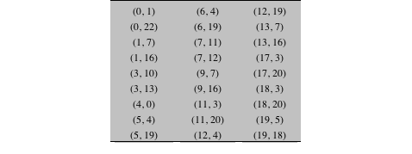
Table 10.1
Points (other than O) on the Elliptic Curve E₂₃(1, 1)
Notes:
Table 10.1 Points (other than O) on the Elliptic Curve E23(1, 1)

Slide 22
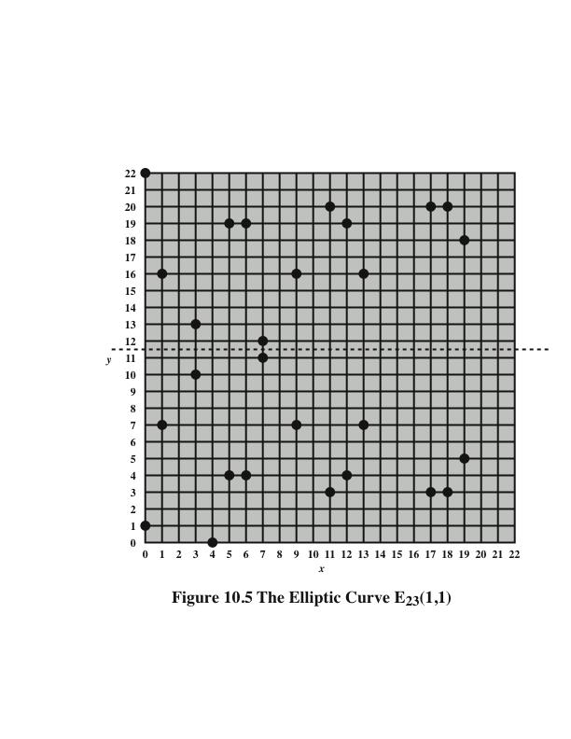
Notes:
Figure 10.5 plots the points of E₂₃ (1, 1); note that the points, with one exception, are symmetric about y = 11.5.

Slide 23
Elliptic Curves Over GF(2^{m})
Use a cubic equation in which the variables and coefficients all take on values in GF(2^{m}) for some number m
Calculations are performed using the rules of arithmetic in GF(2^{m})
The form of cubic equation appropriate for cryptographic applications for elliptic curves is somewhat different for GF(2^{m}) than for Z_{p}
It is understood that the variables x and y and the coefficients a and b are elements of GF(2^{m}) and that calculations are performed in GF(2^{m})
Notes:
Recall from Chapter 4 that a finite field GF(2^{m} ) consists of 2^{m} elements, together
with addition and multiplication operations that can be defined over polynomials.
For elliptic curves over GF(2^{m} ), we use a cubic equation in which the variables and
coefficients all take on values in GF(2^{m} ) for some number m and in which calculations
are performed using the rules of arithmetic in GF(2^{m} ).
It turns out that the form of cubic equation appropriate for cryptographic applications
for elliptic curves is somewhat different for GF(2^{m} ) than for Z_{p} . The form is
y² + xy = x³ + ax² + b

Slide 24
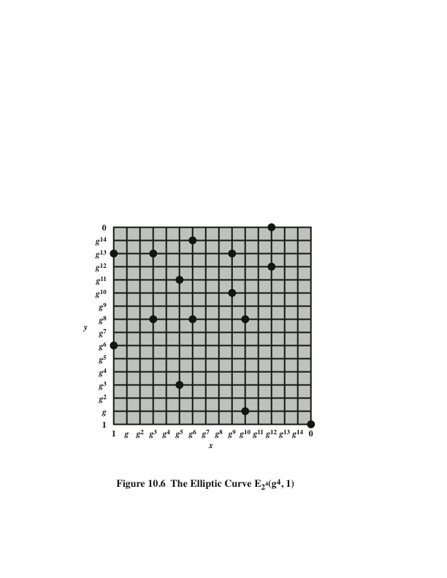
Notes:
Figure 10.6 plots
the points of E₂₄ (g⁴ , 1).

Slide 25
Elliptic Curve Cryptography (ECC)
Addition operation in ECC is the counterpart of modular multiplication in RSA
Multiple addition is the counterpart of modular exponentiation
Certicom example: E₂₃(9,17)
To form a cryptographic system using elliptic curves, we need to find a “hard problem” corresponding to factoring the product of two primes or taking the discrete logarithm
Q=kP, where Q, P belong to a prime curve
Is “easy” to compute Q given k and P
But “hard” to find k given Q, and P
Known as the elliptic curve logarithm problem
Notes:
Elliptic Curve Cryptography uses addition as an analog of modulo multiply, and repeated addition as an analog of modulo exponentiation. The “hard” problem is the elliptic curve logarithm problem. We give an example taken from the Certicom Web site (www.certicom.com). Consider the group E₂₃(9, 17). This is the group defined by the equation y² mod 23 = (x³ + 9x + 17) mod 23. What is the discrete logarithm k of Q = (4, 5) to the base P = (16, 5)? The brute-force method is to compute multiples of P until Q is found. Thus P = (16, 5); 2P = (20, 20); 3P = (14, 14); 4P = (19, 20); 5P = (13, 10); 6P = (7, 3); 7P = (8, 7); 8P = (12, 17) ; 9P = (4, 5). Because 9P = (4, 5) = Q, the discrete logarithm Q = (4, 5) to the base P = (16, 5) is k = 9. In a real application, k would be so large as to make the brute-force approach infeasible.

Slide 26
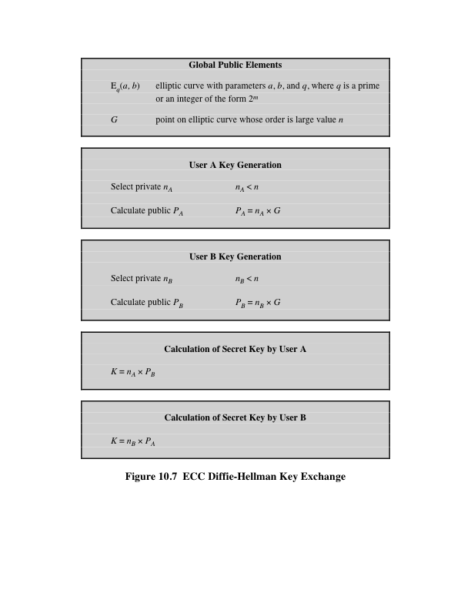
Notes:
Figure 10.7 ECC Diffie-Hellman Key Exchange.

Slide 27
ECC Encryption/Decryption
Several approaches using elliptic curves have been analyzed
Must first encode any message m as a point on the elliptic curve P_{m}
Select suitable curve and point G as in Diffie-Hellman
Each user chooses a private key n_{A} and generates a public key P_{A}=n_{A} * G
To encrypt and send message P_{m} to B, A chooses a random positive integer k and produces the ciphertext C_{m} consisting of the pair of points:
C_{m} = {kG, P_{m}+kP_{B}}
To decrypt the ciphertext, B multiplies the first point in the pair by B’s secret key and subtracts the result from the second point:
P_{m}+kP_{B}–n_{B}(kG) = P_{m}+k(n_{B}G)–n_{B}(kG) = P_{m}
Notes:
Several approaches to encryption/decryption using elliptic curves have been analyzed in the literature. This one is an analog of the ElGamal public-key encryption algorithm. The sender must first encode any message M as a point on the elliptic curve P_{m} (there are relatively straightforward techniques for this). Note that the ciphertext is a pair of points on the elliptic curve. The sender masks the message using random k, but also sends along a “clue” allowing the receiver who know the private-key to recover k and hence the message. For an attacker to recover the message, the attacker would have to compute k given G and kG, which is assumed hard.

Slide 28
Security of Elliptic Curve Cryptography
Depends on the difficulty of the elliptic curve logarithm problem
Fastest known technique is “Pollard rho method”
Compared to factoring, can use much smaller key sizes than with RSA
For equivalent key lengths computations are roughly equivalent
Hence, for similar security ECC offers significant computational advantages
Notes:
The security of ECC depends on how difficult it is to determine k given kP and P .
This is referred to as the elliptic curve logarithm problem. The fastest known technique
for taking the elliptic curve logarithm is known as the Pollard rho method.

Slide 29
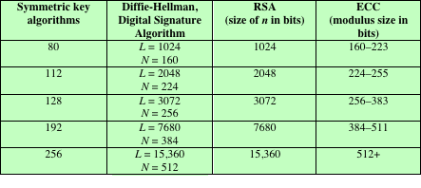
Table 10.3 Comparable Key Sizes in Terms of Computational Effort for Cryptanalysis (NIST SP-800-57)
Note: L = size of public key, N = size of private key
Notes:
Table 10.3, from NIST SP800-57 (Recommendation for Key Management—Part 1:
General , July 2012), compares various algorithms by showing comparable key sizes
in terms of computational effort for cryptanalysis. As can be seen, a considerably
smaller key size can be used for ECC compared to RSA. Furthermore, for equal
key lengths, the computational effort required for ECC and RSA is comparable
[JURI97]. Thus, there is a computational advantage to using ECC with a shorter
key length than a comparably secure RSA.

Slide 30
10.3 椭圆曲线
背景
RSA中用到了因子分解的困难性，而为了增加困难得加大数的位数，从而导致计算速度变慢。
ECC可以用较小的密钥长度达到较高的计算难度
Elliptic Curve
y²＋axy＋by＝x³＋cx²＋dx＋e
其中a、b、c、d、e是满足某个简单条件的实数
另有O点被定义为无穷点/零点
点加法P＋Q＝R定义为
过P、Q和椭圆曲线相交的第三点的X轴对称点R

Slide 31
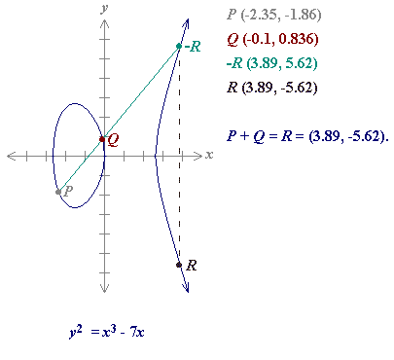
EC：P＋Q＝R

Slide 32
素域上的EC
在有限域Z_{p}上的简化EC
y²≡x³＋ax＋b mod p
其中4a³＋27b² mod p ≠ 0
（这是一个离散点的集合）
举例
y²≡x³＋18x＋15 mod 23
y²≡x³＋17x＋15 mod 23
Notes:
http://www.certicom.com/research/ec33_example.html

Slide 33
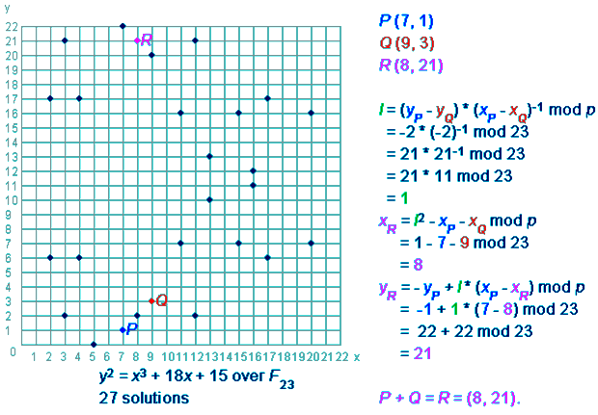
EC (1)

Slide 34
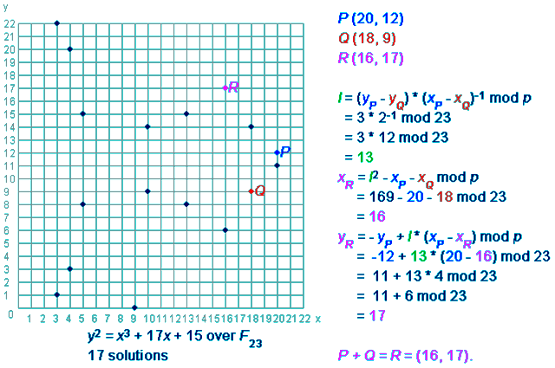
EC (2)

Slide 35
EC上的离散对数问题（ECDLP）
Q＝k×P中的k计算也是极其困难的
k×P表示k个P相加：P + P + … + P
在DH密钥交换中
使用了y＝g^{x} mod p中x的计算困难性
同样在ECC中
将使用Q＝kP中计算k的困难性
有两个应用
密钥交换
加密解密

Slide 37
10.4 椭圆曲线密码学ECC
ECC利用EC上的离散对数难题(ECDLP)，这和利用Zp*上的离散对数难题(DLP)是一样的方法。
在一般数域上的离散对数问题（以及大数分解问题）存在亚指数级时间复杂度求解算法，而ECDLP只有纯指数算法。

Slide 38
使用EC的密钥交换（D-H）
步骤
y²≡x³＋ax＋b mod p
选择素数p(得约160＋比特)和参数a、b
选择一个生成点G＝(x1，y1)
p、a、b和点G是公开的
A：选取秘密的数N_{a}，计算P_{a}＝N_{a}×G
B：选取秘密的数N_{b}，计算P_{b}＝N_{b}×G
交换P_{a}，P_{b}
A：计算K＝N_{a}×P_{b}＝N_{a}×N_{b}×G
B：计算K’＝N_{b}×P_{a}＝N_{b}×N_{a}×G
分析
攻击者得求N_{a}和N_{b}，就是P＝?×G中的?

Slide 39
用EC的加解密
准备
曲线参数p、a、b、G，y²≡x³＋ax＋b mod p
A有自己的私钥N_{a}，并产生公钥P_{a}＝N_{a}×G
B有自己的私钥N_{b}，并产生公钥P_{b}＝N_{b}×G
加密 （A要给B发送消息）
对明文m的编码点P_{m}，选择随机数k，密文
C＝{C₁，C₂} ＝ {k×G，P_{m}＋k×P_{b}}
解密：
编码点P_{m}＝C₂－N_{b}×C₁，因为
＝(P_{m}＋k×P_{b})－N_{b}×k×G
＝P_{m}＋k×N_{b}×G－N_{b}×k×G ＝ P_{m}

Slide 40
用EC的加解密
原理
先是通过k×P_{b}掩盖P_{m} (即m)，又通过k×G掩盖k
知道陷门N_{b}则可以轻松恢复之
分析
攻击者解C₁＝k×G中的k困难性

Slide 44
关于速度
速度
在密钥长度相等的情况下，RSA和ECC的速度相当；
但是在相同的安全强度要求下，ECC可以使用较少的位数就可以；
故
ECC较好
适合嵌入式设备中

Slide 45
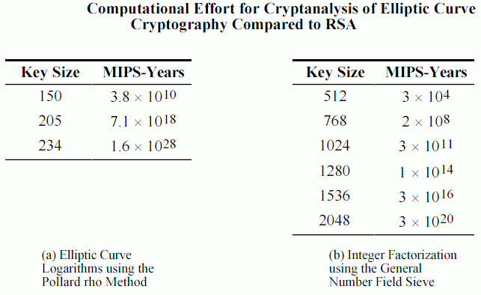
ECC vs. RSA

Slide 46
ECC STD
Pkcs#13 proposal
http://www.rsasecurity.com/rsalabs/pkcs/pkcs-13/index.html
ECC Cryptography Tutorial
http://www.certicom.com/index.php?action=ecc_tutorial,home
ANSI X9.62
FIPS 186-2
IEEE P1363: Standard Specifications For Public Key Cryptography
http://grouper.ieee.org/groups/1363/
ISO/IEC 15946

Slide 47
关键词 Key Terms
abelian group binary curve
cubic equation Diffie-Hellman key exchange
discrete logarithm elliptic curve
elliptic curve arithmetic
elliptic curve cryptography
finite field key distribution
key management man-the-middle attack
prime curve primitive root
public-key certificate public-key directory
zero point

Slide 48
小结
公钥算法没有对称算法那样多，但是对称算法都是基于替代和置换的组合应用技巧，而公钥算法各自使用不同的背景难题。
目前常用有三个背景难题：大数分解(IFP)，离散对数问题(DLP)，椭圆曲线上的DLP(ECDLP)。
随着计算能力的日益增长，公钥算法的密钥宽度也需要与时俱进。
公钥算法仍需要和对称算法结合使用，各自发挥优点，避免缺点。

Slide 49
Summary
Diffie-Hellman Key Exchange
The algorithm
Key exchange protocols
Man-in-the-middle attack
Elgamal cryptographic system
Elliptic curve cryptography
Analog of Diffie-Hellman key exchange
Elliptic curve encryption/decryption
Security of elliptic curve cryptography
Elliptic curve arithmetic
Abelian groups
Elliptic curves over real numbers
Elliptic curves over Z_{p}
Elliptic curves over GF(2^{m})
Pseudorandom number generation based on an asymmetric cipher
PRNG based on RSA
PRNG based on elliptic curve cryptography
Notes:
Chapter 10 summary.

